Slide 1
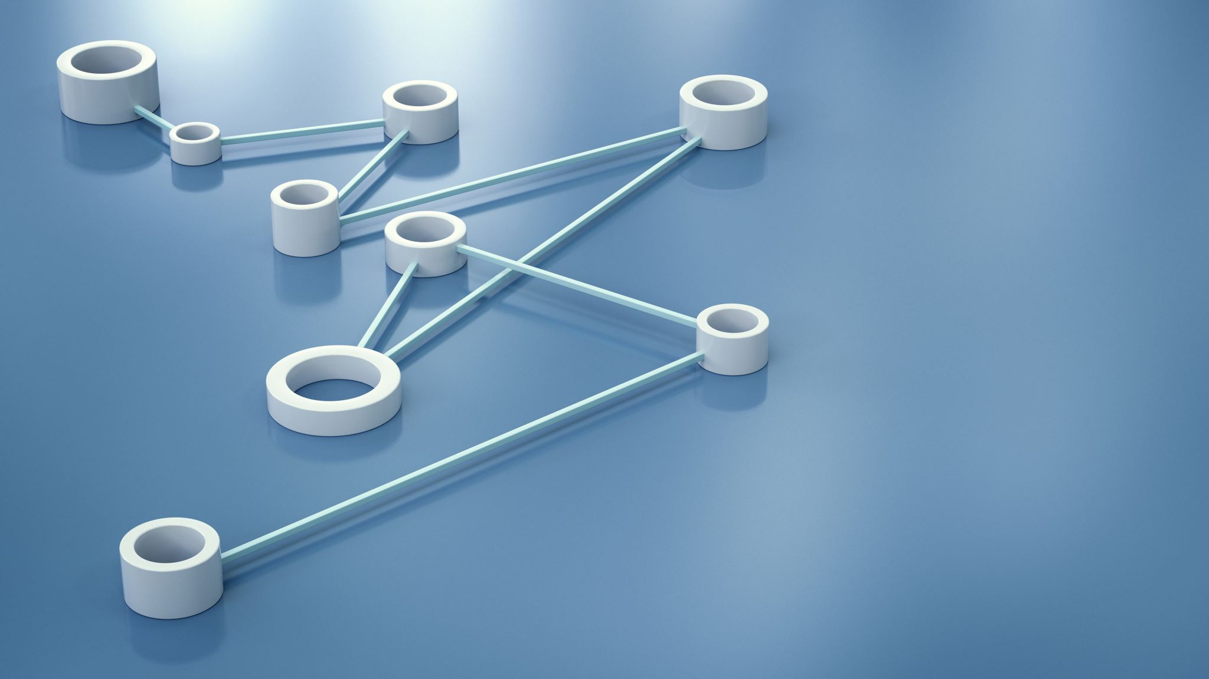

Project 9: IoT Based Load Management System -Team 9

Slide 2
Team MEMBERS
Sanchit Jalan- 2022101070
Anish Joishy- 2022111014
Vyakhya Gupta- 2022101104
Aditya Garg- 2022101083
Chirag Dhamija- 2022101039
Archisha Panda-2022111019
Alex-2022101028
DivyaPrakash-2022101129
Krishna-2022101002
Varshitha-2022101054

Slide 3
Problem At Hand
Power generation from solar panels is variable due to variations in solar irradiance, temperature and other components. Often when a system is entirely based on solar powering, it tends to compromise on the regularity and availability of power.
Conventional energy sources guarantee 24/7 availability of power but are limited on a long term basis and come at the cost of serious environmental damages.
What the current situation demands is striking the right balance between the two or in other words maximize the use of solar energy and minimize that of conventional while ensuring uninterrupted power supply.
The aim of the project is to design an intelligent IoT based system that efficiently switches between Solar and Conventional Energy based on the load requirements of the user while ensuring a regular power supply.

Slide 4
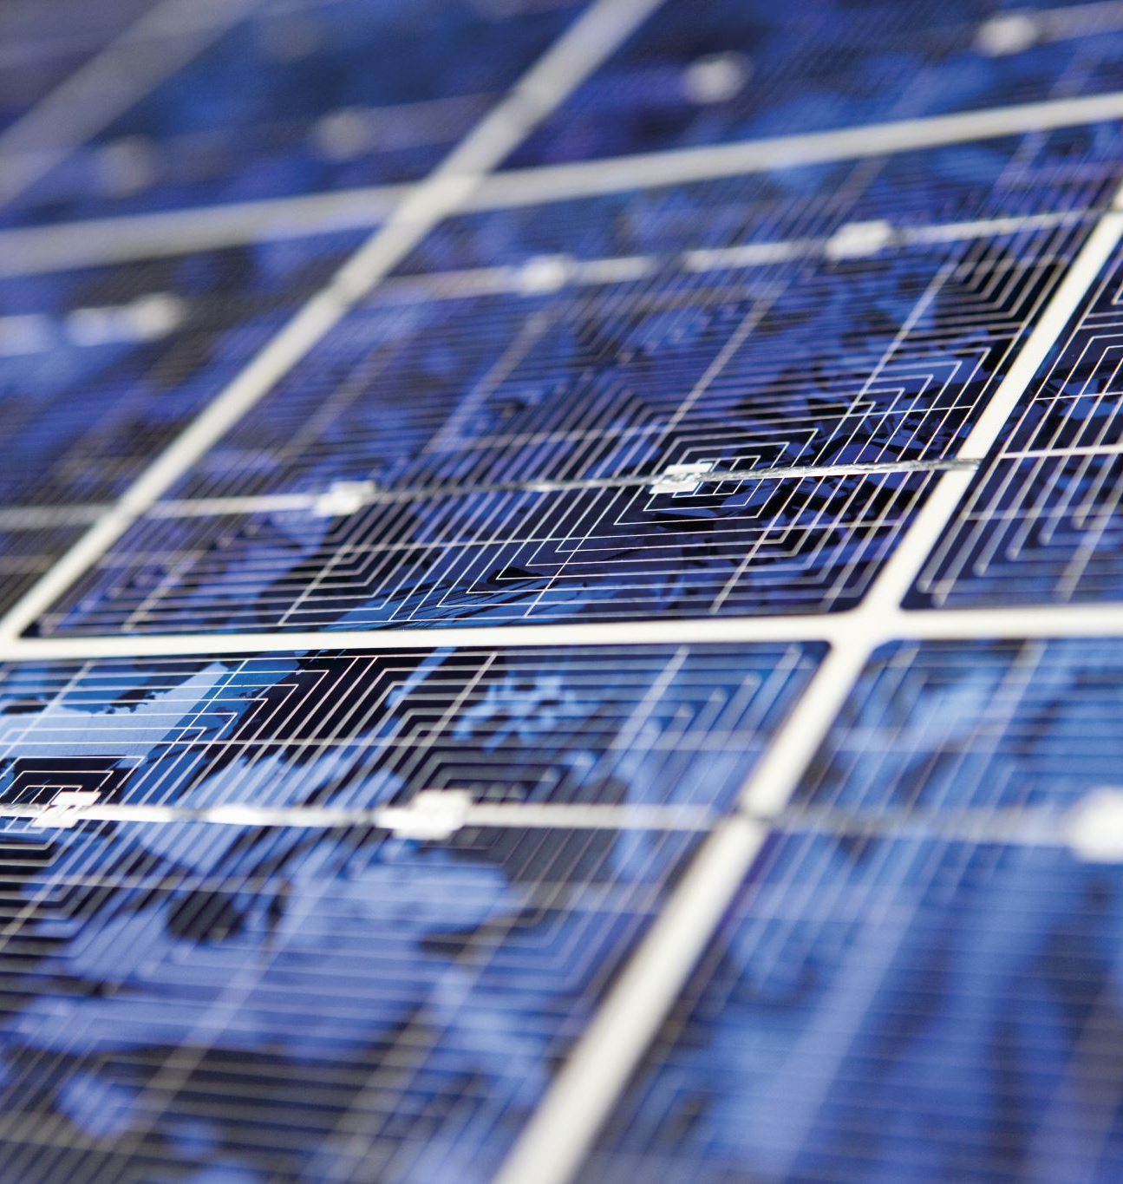


Motivation
Suppose we have eco-system with 3 units namely a hospital, a shop and a factory.
It is naturally expected that the hospital should never face a power failure but at the same time we want to power all the units with solar energy as much as possible.

Slide 5
Our Pitch
Usually at 11-12pm the midday sun is at its highest intensity. Hence, we will power all 3 units with solar power while conventional is driven to 0.
Around 4-5 pm in the afternoon, the Sun starts to set hence the solar current decreases and it is likely that it will not be able to power all 3 units. Since we need to maximize solar and minimize conventional, we switch to a combination of solar and conventional to power the system.
During the evening around 6-7pm the solar energy is negligible. To minimize conventional we need not power the factory ,thus we shall power the other 2 units using conventional current.
At night, it is optimal to only power the hospital as it is our priority for which we will use conventional.
Without IoT, we would need to hire someone to connect and disconnect the respective circuits. However using the knowledge and resources IoT has, we have created an automatic switching system that relays between Solar and Conventional depending on load requirements.

Slide 6

Team Members and Contribution
UI(frontend) + ThingSpeak :- Chirag, Alex, Aditya, Krishna
UI(backend) + OM2M:- Vyakhya, Archisha
Light Dependent Resistor:-Varshitha, Archisha
Esp Coding + Hardware:- Sanchit, Anish, Divyaprakash

Slide 7
Project Features
Automatic switching between Solar and Conventional depending on load requirements.
User Interface-based notifications of abnormal energy consumption.
User interface-based readings of power outages and consumption.
User interface-based prompts giving energy-saving suggestions.
Integration with other renewable energy sources (wind) to reduce dependence on non-renewable energy sources.
Predictive analysis of energy usage patterns based on user behavior.
Automatic optimization of energy usage based on the user's schedule and energy usage patterns.
Real-time monitoring and control of energy consumption of various devices and appliances.
Priority-wise supply of power in various buildings, for example, a hospital would be on top priority while deciding distribution and mode of power supply.

Slide 8

HARDWARE components
Current Sensors
LDRs
Relays
Motors
Solar Panels
Breadboard
Wires
ESP-32
USB Cables
Resistors

Slide 9
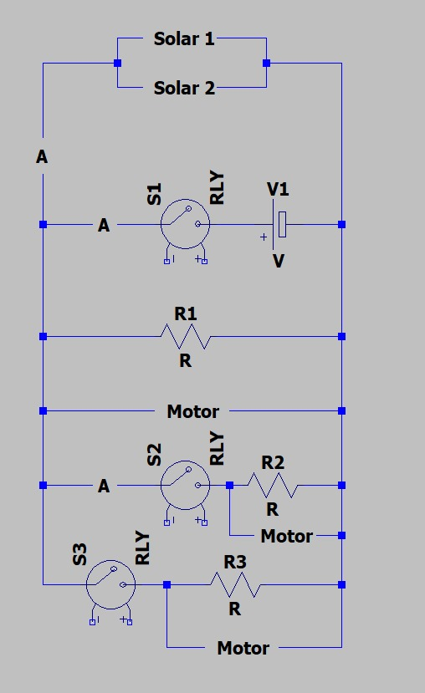
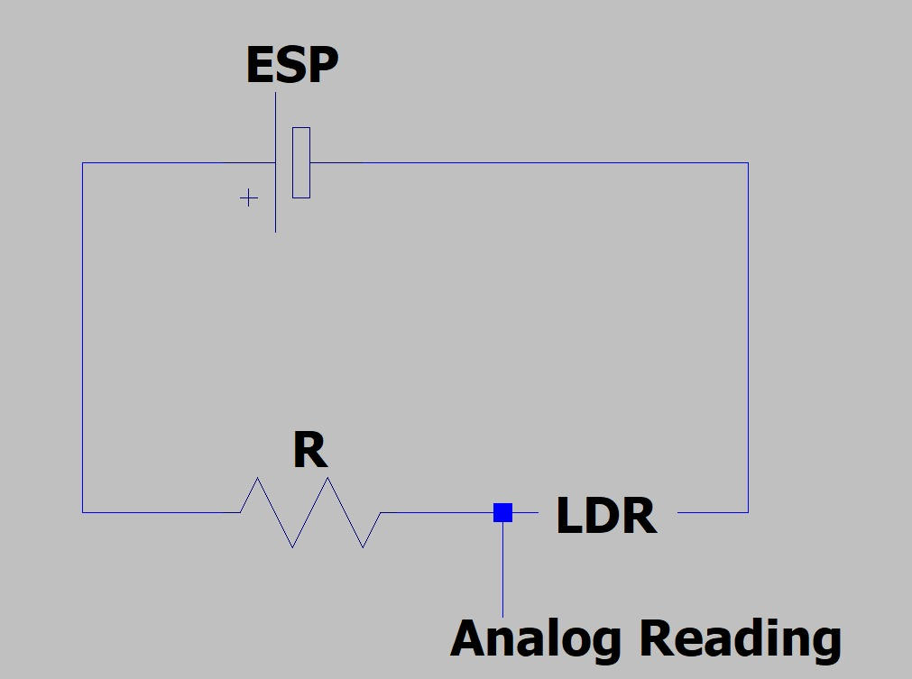
Hardware Diagram

Slide 10
Software Diagram
Relay Switch
Loads
LDR
ESP-32
OM2M
Current Sensor
ACS 712
ThingSpeak
Webpage

Slide 11
Current Status
Automatic switching between Solar and Conventional depending on load requirements.
User Interface-based notifications of abnormal energy consumption.
User interface-based readings of power outages and consumption.
Real-time monitoring and control of energy consumption of various devices and appliances.
Priority-wise supply of power in various buildings, for example, a hospital would be on top priority while deciding distribution and mode of power supply.

Slide 12
Pending
Predictive analysis of energy usage patterns based on user behavior.
Automatic optimization of energy usage based on the user's schedule and energy usage patterns.
Building a 3-D model of our idea and circuit beautification

